Slide 1
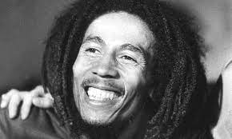
Bob Marley
Jamaican
Reggea

Slide 2
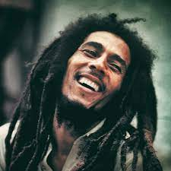
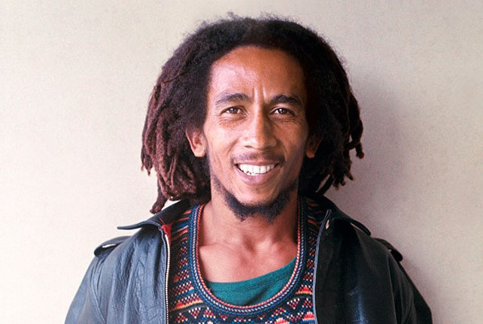
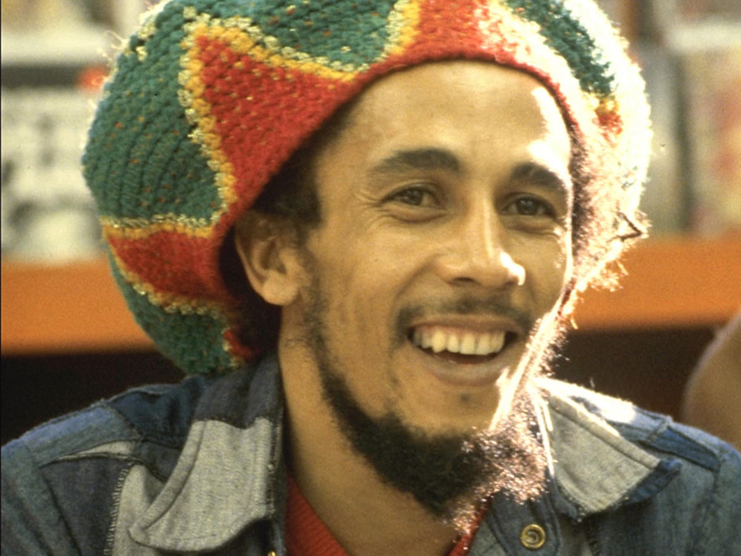
Instruments
He played: bass drums, electric guitar, keyboard and organs

Slide 3
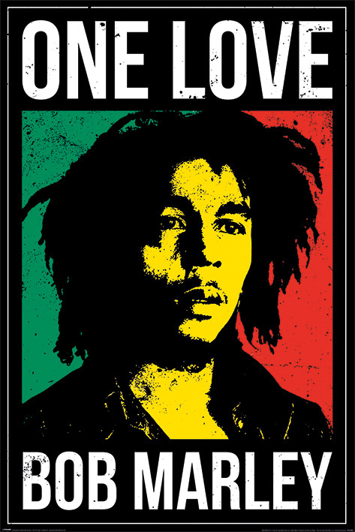
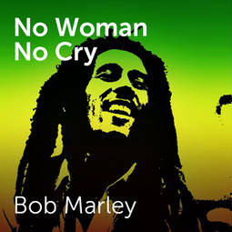
Popular songs
Two of the popular songs are called:
No woman, no cry
one love

Slide 4
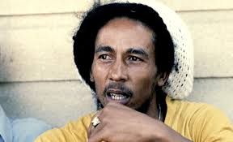
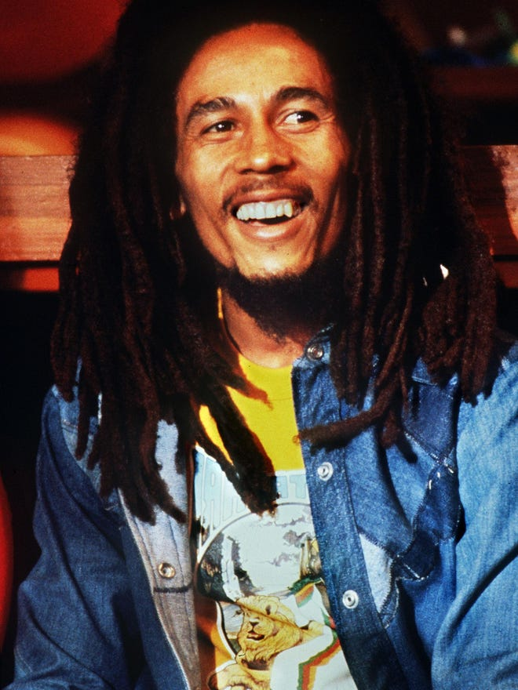
Facts
He Was A Palm reader Before He Was A Singer
He Had Many Children

Slide 5
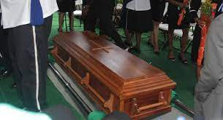
Date born and died
He was born 6 februar 1945 in jamaica
He died 11 mai 1981 in a hospital in florida

Slide 6
Lyrics
His lyrics were about:
Some were about injustice
And some about racism

Slide 7
End
Because i learned about him and im uncreative and cant come up with a favorite artist. The songs are good
They are not my style. I liked the rhythm

Slide 8
More facts
He was from jamaica
He was black
He was popular
He was a artist
He died in florida
He died in usa
He had black hair
He had drugs
He had dreads
He drank alcohol
He drank water
Rita marley was his wife
She died from a stroke
She drank water
She drank alcohol
She was the wife of bob marley
She was born in 1966
She died in 1981

